Slide 1


213CSE4307 DIGITAL FORENSICS
Brute-Force Password Cracking for Automated PDF Decryption with a Graphical Interface
Team Details
K.Bhavesh Shankar – 99220040083
S.Imran – 99220040204
Ch.Gopi Krishna – 99220040367
T.Jani Reddy - 99220040356
Course Handling Faculty
Dr. K. Venkatesh
Assistant Professor
Department of Computer Science and Engineering,
Kalasalingam Academy of Research and Education

Slide 2

Investigating Cybercrime:
A Problem-Based Learning Approach to Digital Forensics
Theme of the Course
In today's digital age, cybercrime has become increasingly sophisticated, posing significant challenges to law enforcement agencies, corporations, and individuals. Digital forensics plays a crucial role in investigating cybercrimes by identifying, preserving, analyzing, and presenting digital evidence. As digital devices and data storage methods evolve, the complexity of digital forensics increases, requiring continuous adaptation and learning.
Context
Scenario
Capital One, a major financial institution, experienced a significant data breach in 2019, where a former employee of Amazon Web Services exploited a misconfigured firewall to gain unauthorized access to Capital One's cloud-based data. The breach resulted in the exposure of personal information of over 100 million customers, including names, addresses, credit scores, and social security numbers.
Recent – FedEx Cargo – Data Breach

Slide 3
Agenda
Introduction
Why I prefer these concept
How my project will solve that problem
Modules
Sample output
Certifications
Applied journals for the IEEE Scopus Indexed conference.

Slide 4
Introduction
Purpose : The program's goal is to use a password list and a brute-force method to decrypt PDF files that are password-protected. It does this by using a graphical user interface (GUI).
Packages used : Constructed using PyPDF2 for handling PDF encryption and decryption, and Tkinter for the Python interface.
Features :
User-friendly file browsing for selecting PDF files, password lists, and output files.
A brute-force decryption process that tries each password from the list until the correct one is found.
Ability to save the decrypted PDF if the correct password is discovered.
User Interface : Users can select the encrypted PDF, the password list, and specify where the decrypted file should be saved.

Slide 5
Why we prefer this concept
This project comes under the Breaking Encrypted data access and titled as “Brute-Force Password Attack for Automated PDF Decryption with a Graphical Interface”. We chosen this project to provide a legal solution for organizations facing the issue of forgetting passwords on important or old PDF files. In Real-world Events it can lead to staff members or even entire teams forgetting passwords which can prevent access to crucial documents.
This project gives ability to regain access to their files by using brute force method and decrypt the pdf file.

Slide 6
How our project will solve that problem
Our project offers a safe and automated brute-force decryption technique, which addresses the issue of forgotten PDF passwords. This application employs a password list to methodically try to unlock a file in the event that an organization forgets the password to a crucial document. Users can upload an encrypted PDF and a password list with ease using the graphical interface, and the program will handle the decryption in the background.
Employees frequently remember important components or pieces of the original password—such as a well-known word, a string of numbers, or particular character patterns—when an organization loses its password. They can come up with different password combinations using these fragmented memories, whether it be different capitalizations, numerics, or special characters. By creating a list of these possible passwords, they can drastically reduce the number of options.
The program decrypts the file and lets the user save a password-free, accessible version after it has determined the correct password. This makes sure that important documents can be retrieved without erasing data or using unreliable external techniques.
This project is Trail and error method .It works Perfectly and catch the password based on the Employees Password list other wise it will be failed to crack password.

Slide 7
Modules
Graphical Setup :
Using the Tkinter library, this module manages the graphical user interface, offering a user-friendly way to select files, see input fields, and start the decryption process.
PDF File Handling :
This module is in charge of interacting with the PDF file, determining whether it is encrypted, and making an effort to decrypt it with the passwords supplied.
Brute-Force :
This module performs the core functionality of the application, iterating over a list of potential passwords to find the correct one.
Decrypted PDF Saving :
After successfully decrypting the PDF, this module allows saving the decrypted version to a specified output file.
Error Handling :
This module handles user input validation, error messages, and success notifications using messagebox.
Main Application :
The final module that launches the application and ensures the graphical interface remains active.

Slide 8
Flow chart :
start
Select encrypted pdf
Select passwords file
Brute force attack
Decrypting pdf
Success
fails
Save decrypted pdf
End

Slide 9
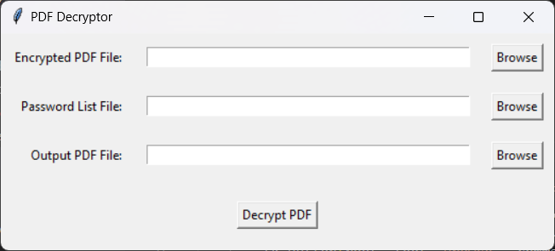
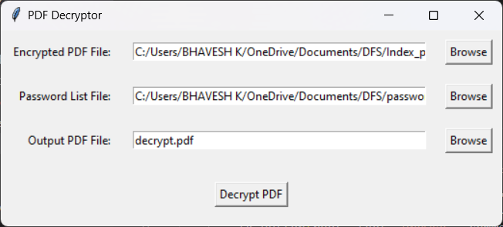
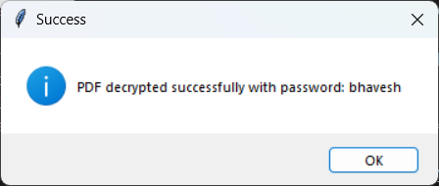
Sample output

Slide 10
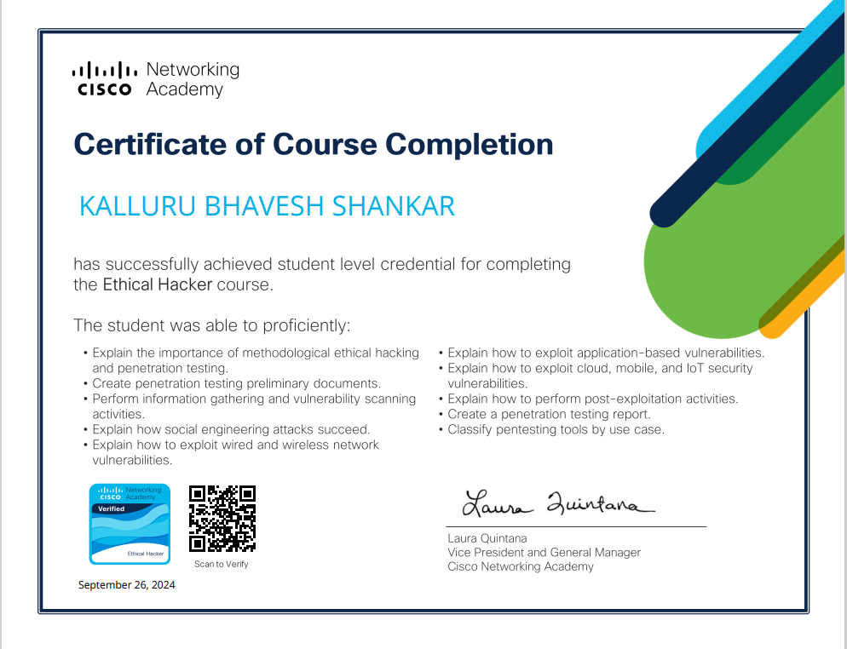
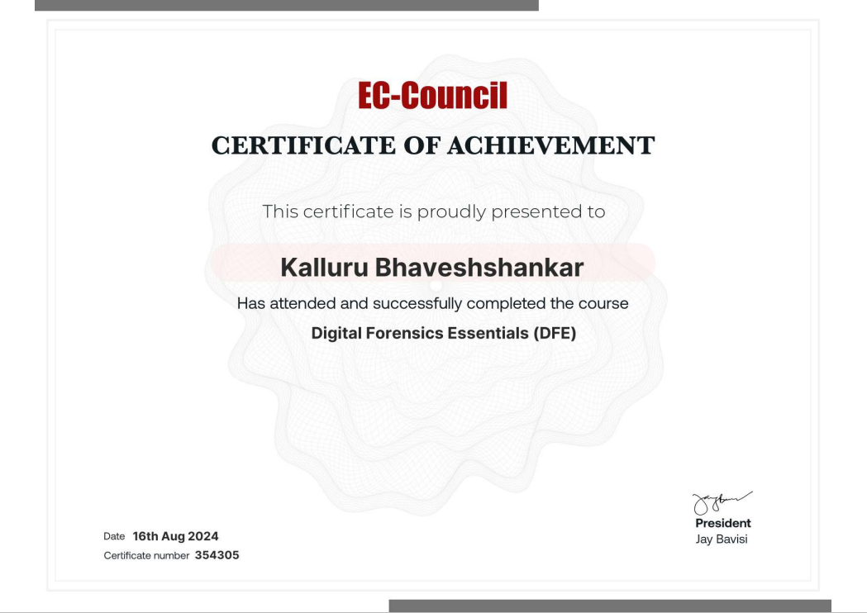
Certifications
We learned tools from these certifications which are Information Gathering, Vulnerability scanning, Penetration testing ,Wireless network tools, password cracking and preserving digital evidences.
A thorough understanding of fundamental ethical hacking techniques, including vulnerability analysis, penetration testing, and exploitation strategies, is demonstrated by certification. The course prepares students to defend against cyber threats in an organized and legal way by teaching them how to recognize and fix security flaws in networks, applications, and devices.

Slide 11
IEEE Journals
We applied this Project for the IEEE Scopus Indexed conferences. We applied for the two conferences.
The TEECCON 2024 (Third International Conference on Trends in Electrical, Electronics, and Computer Engineering) is an IEEE-sponsored conference organized by the IEEE Bangalore Section.
5 th International conference on. Data Intelligence and Cognitive Informatics.

Slide 12
Thank you

